Slide 1
Docker

Slide 2
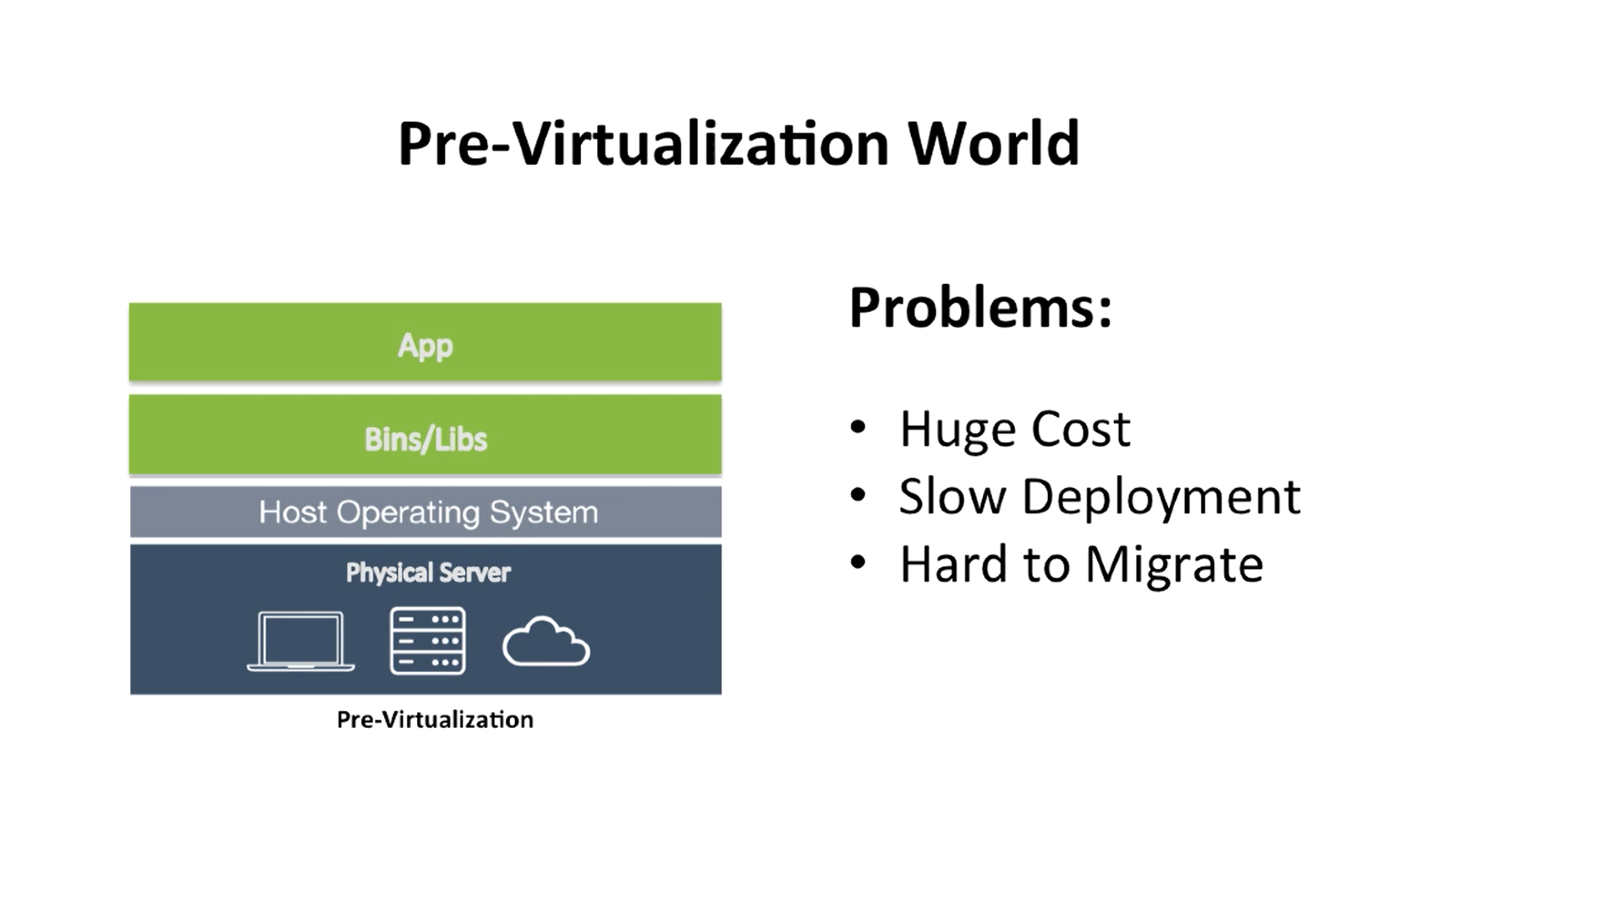
Virtualization (1)

Slide 3
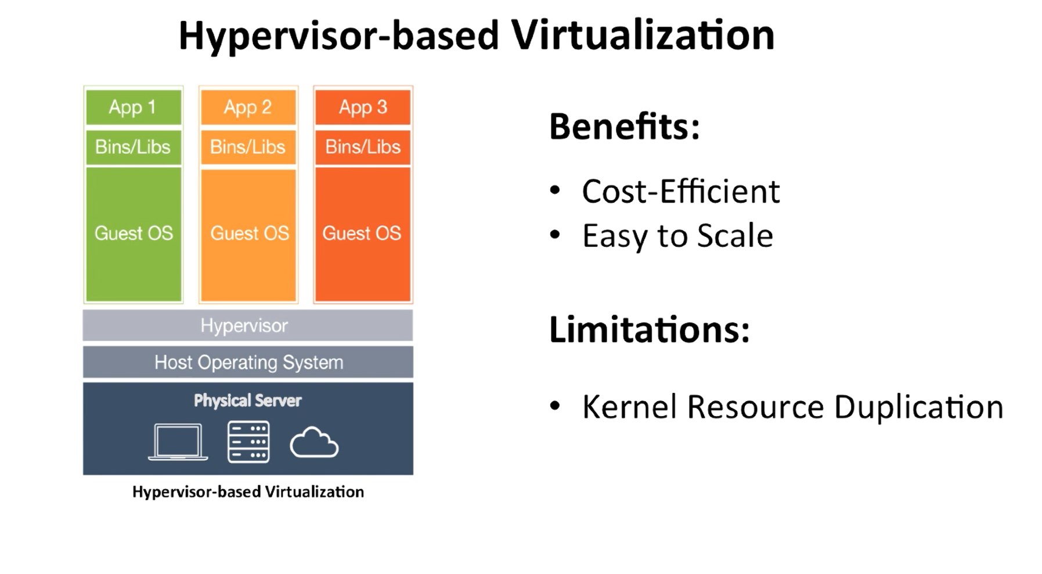
Virtualization (2)

Slide 4
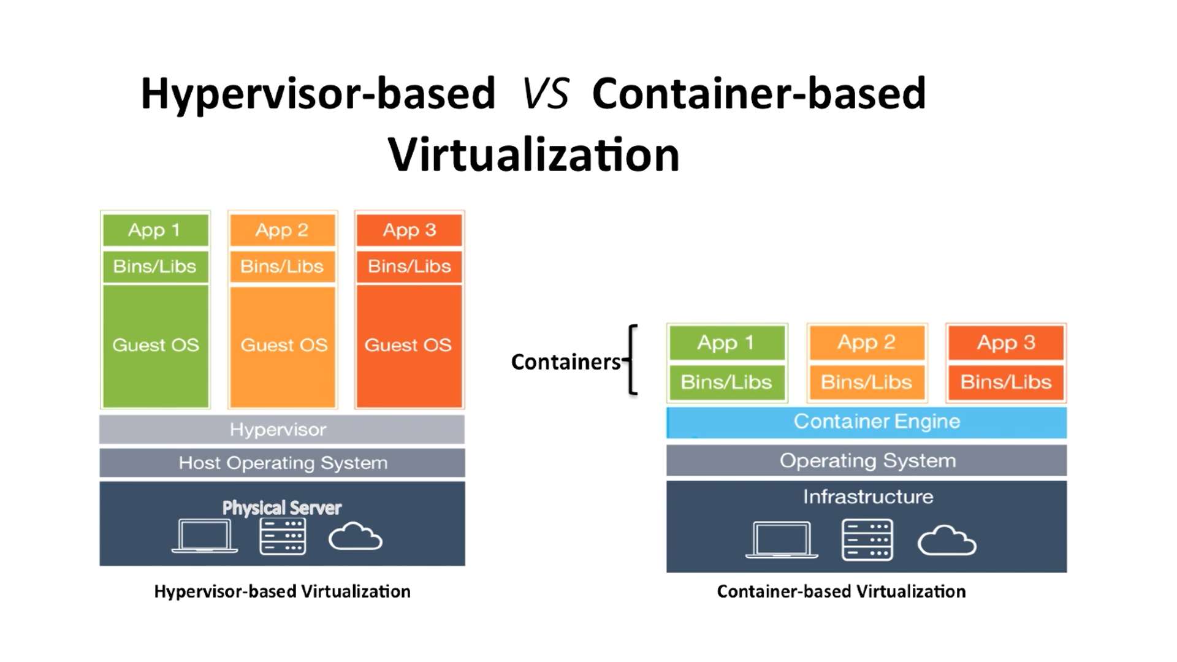
Virtualization (3)

Slide 5
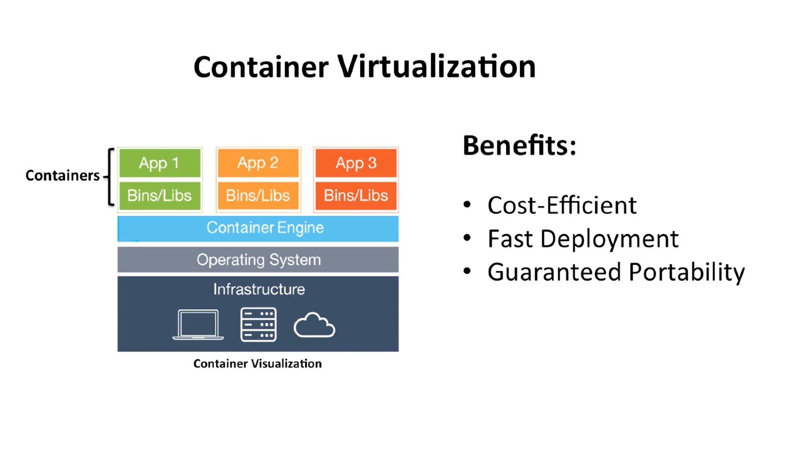
Virtualization (4)

Slide 6
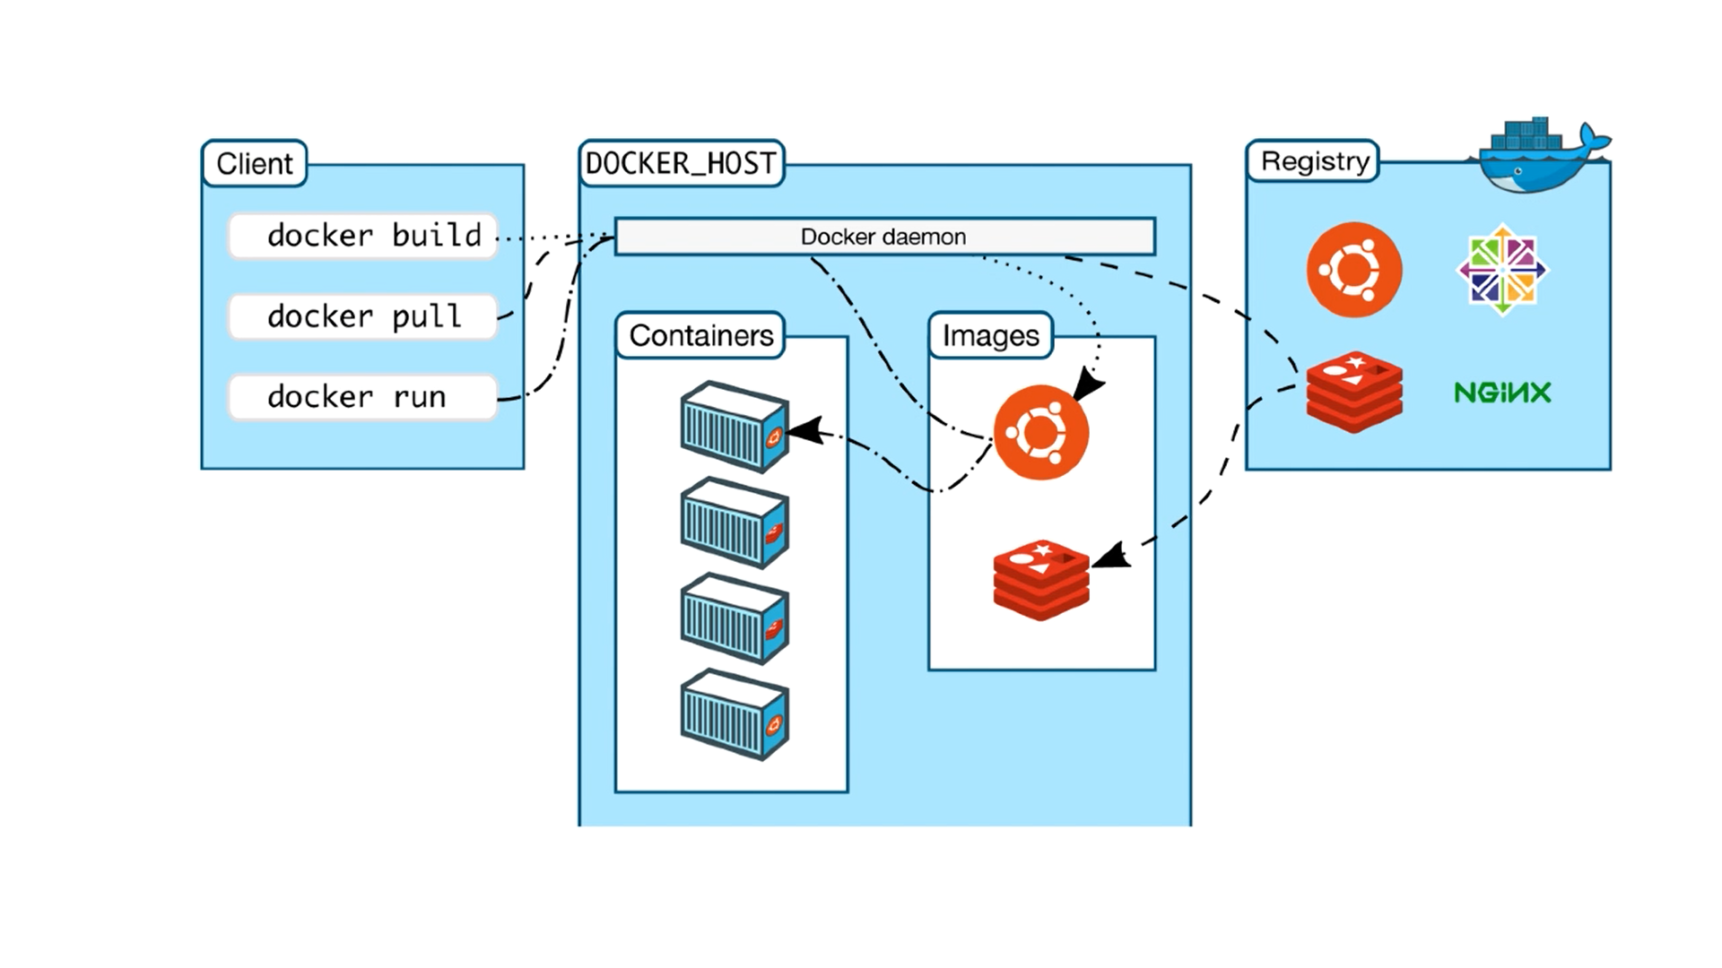
Client/Server

Slide 7
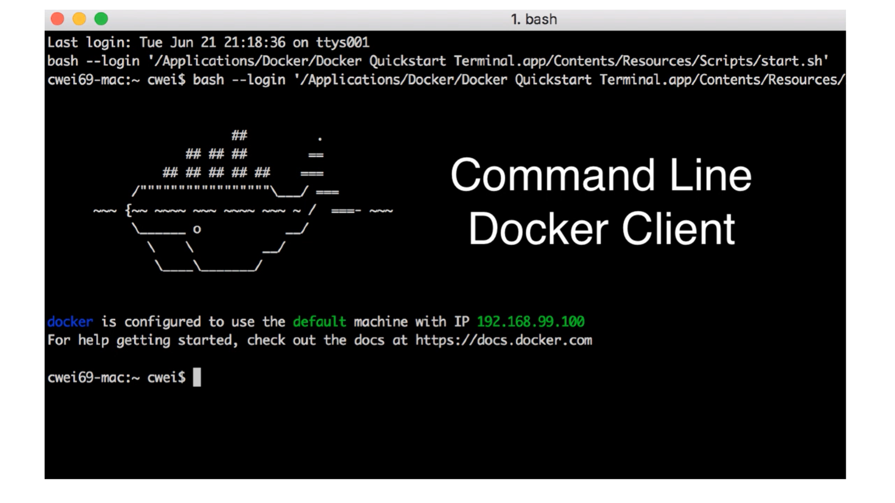
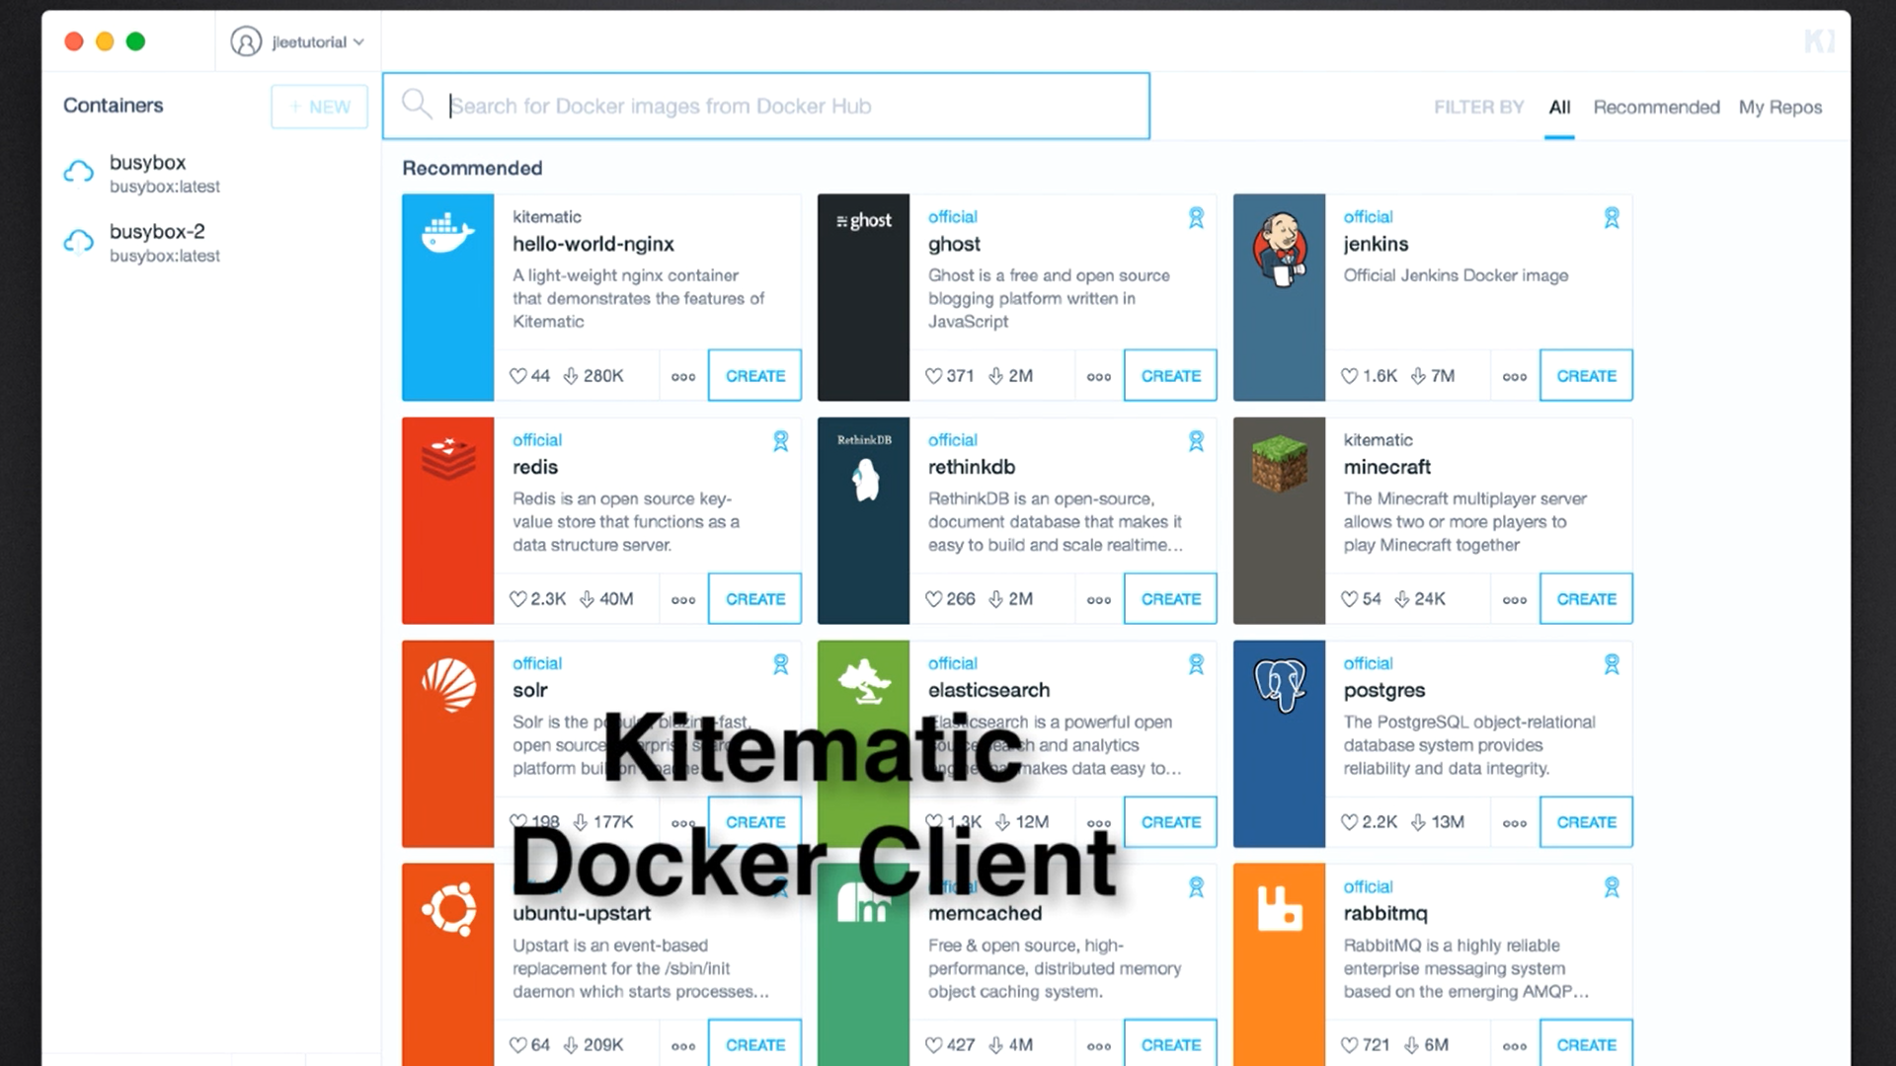
Client Interfaces

Slide 8
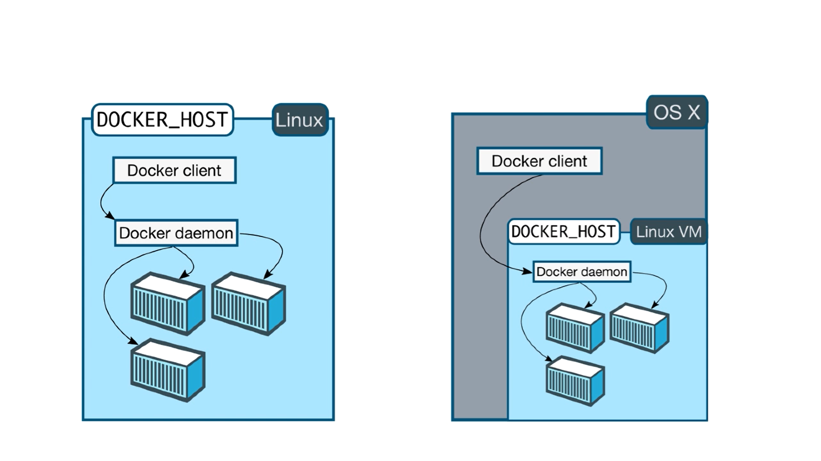
Only Linux Docker Host

Slide 9
Docker Client and Docker Toolbox
Docker Client
Docker Toolbox
Mac OS X 10.10.3 or newer
Windows 10 or newer
Mac older than OS X 10.10.3
Windows older than Windows 10
Needs VirtualBox
Not compatible with Hyper-V

Slide 10
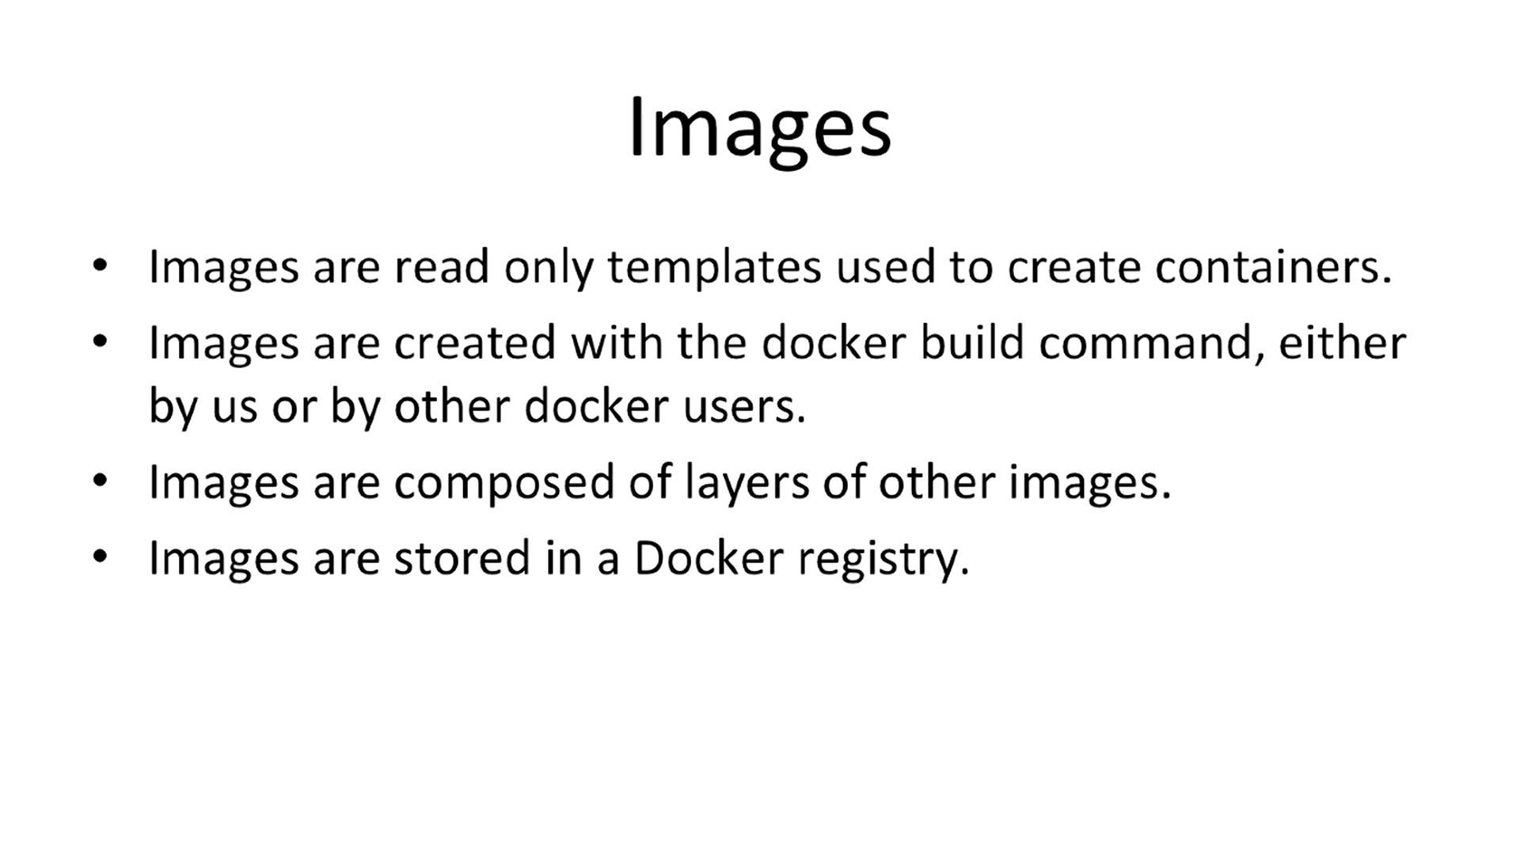
Concepts (1)

Slide 11
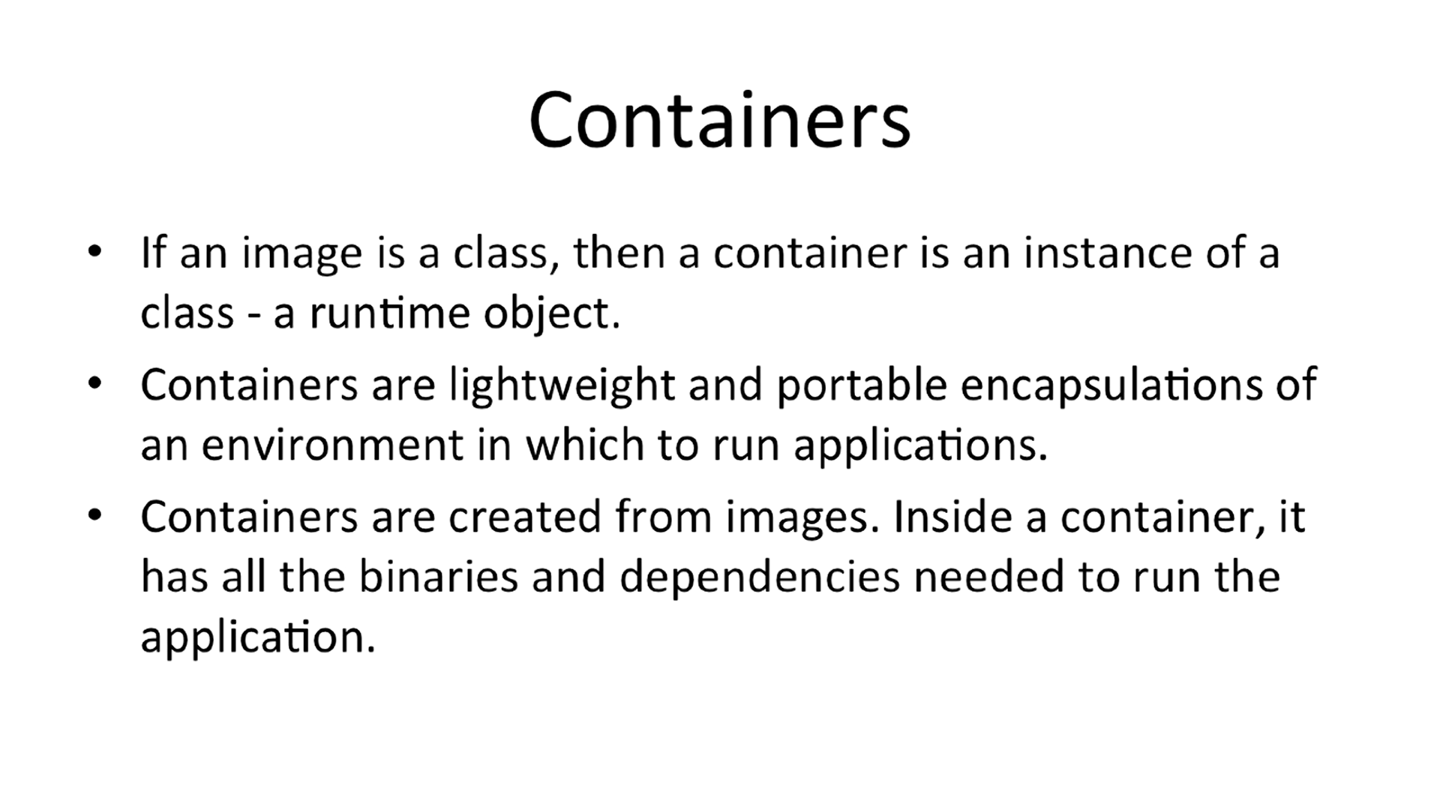
Concepts (2)

Slide 12
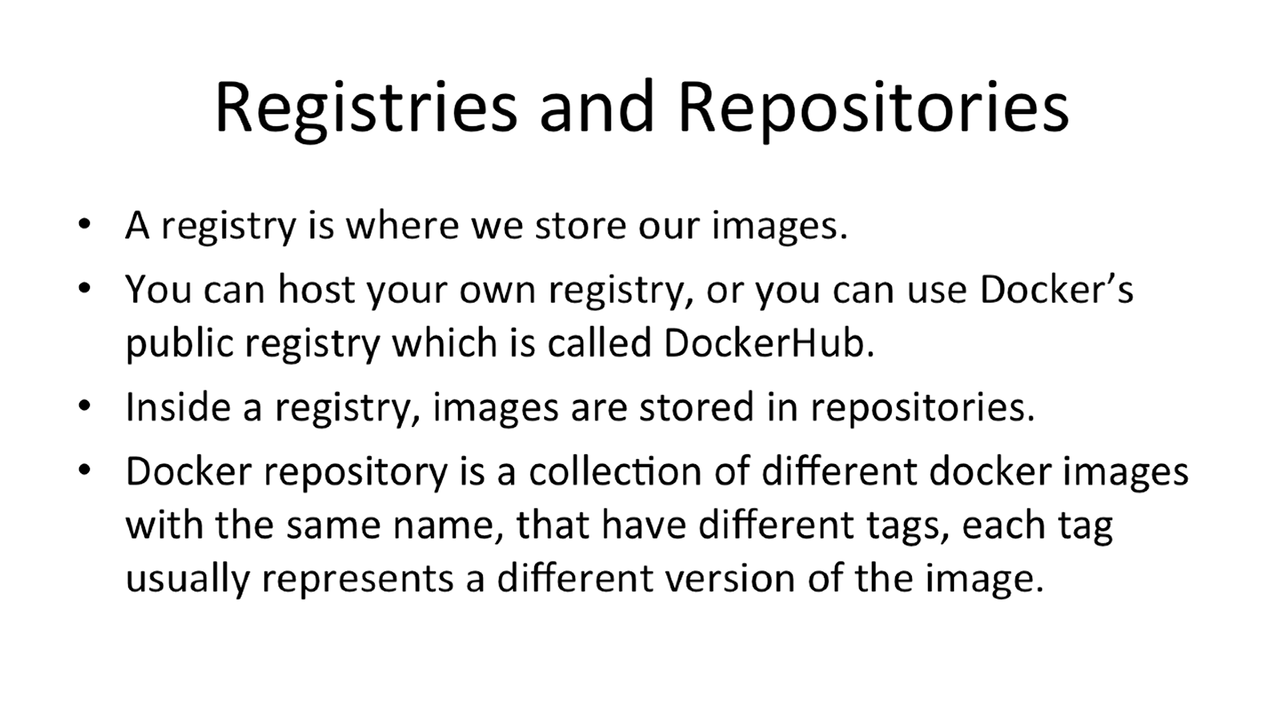
Concepts (3)

Slide 13
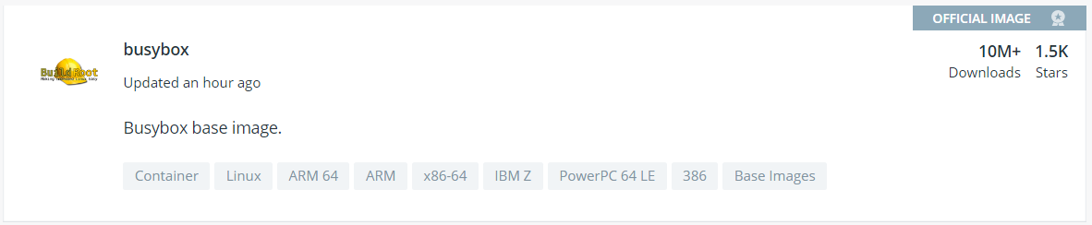
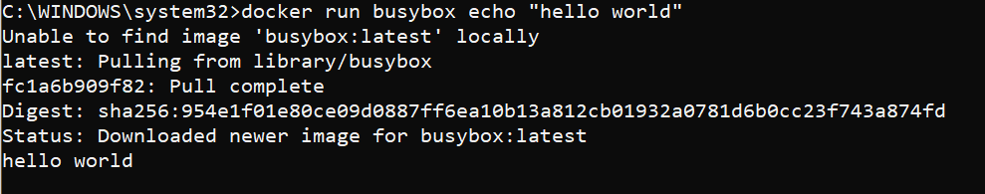
Hello World
Choose image on Docker HUB
Choose TAG
BusyBox
Commands
docker images
docker run busybox:1.24 [command]
=> echo «hello world»

Slide 14
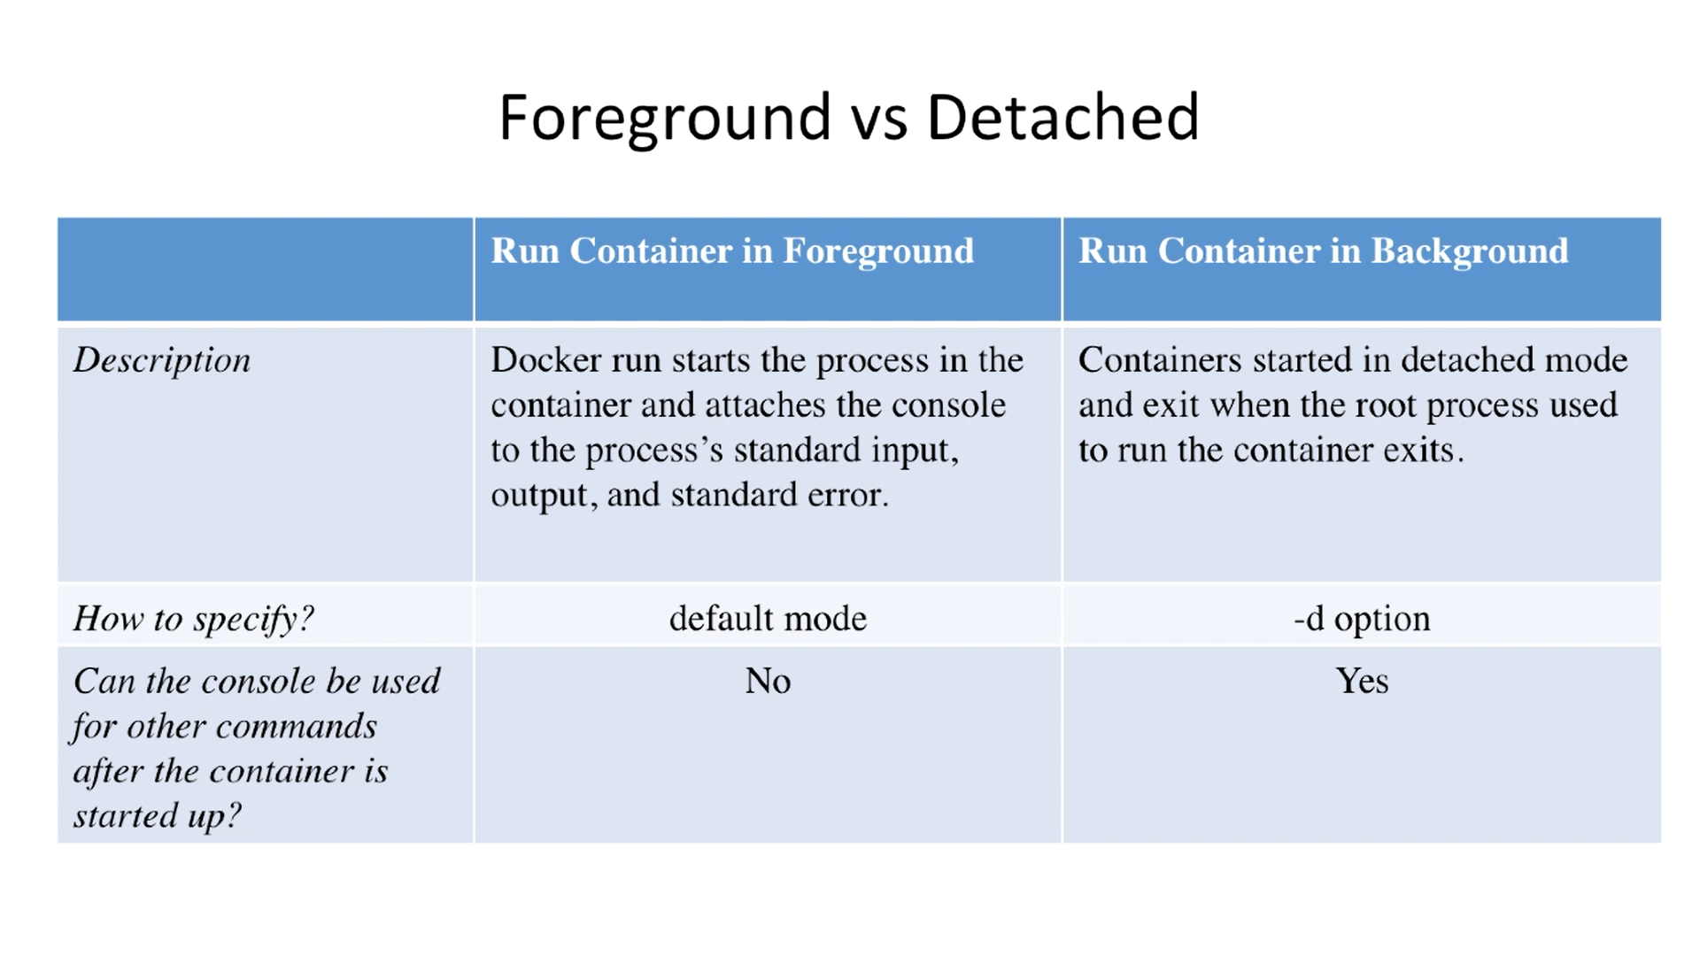
Containers

Slide 15
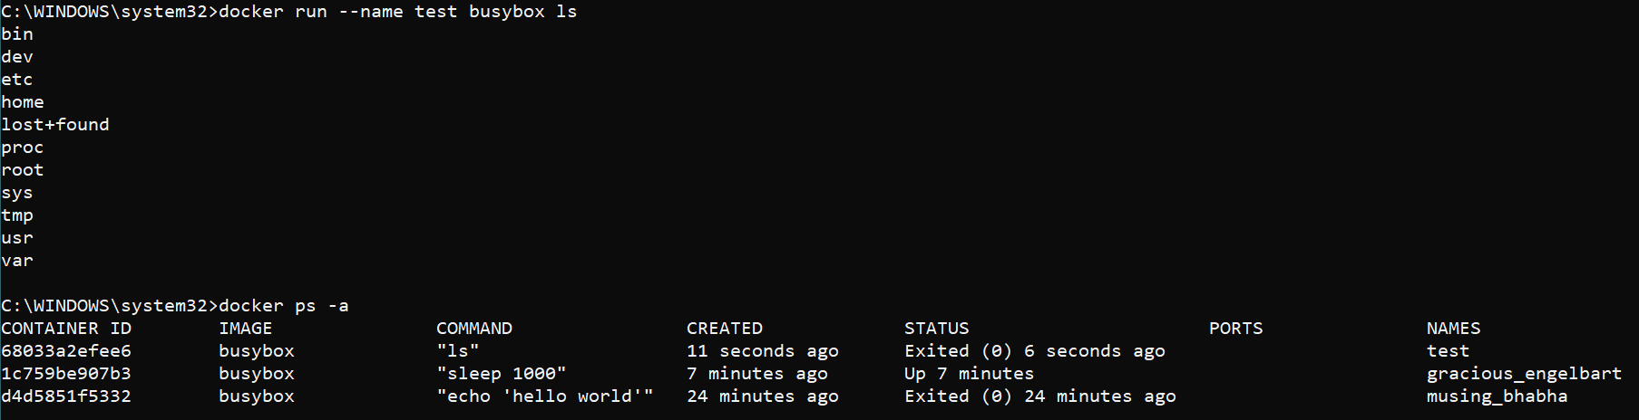
Examples

Slide 16
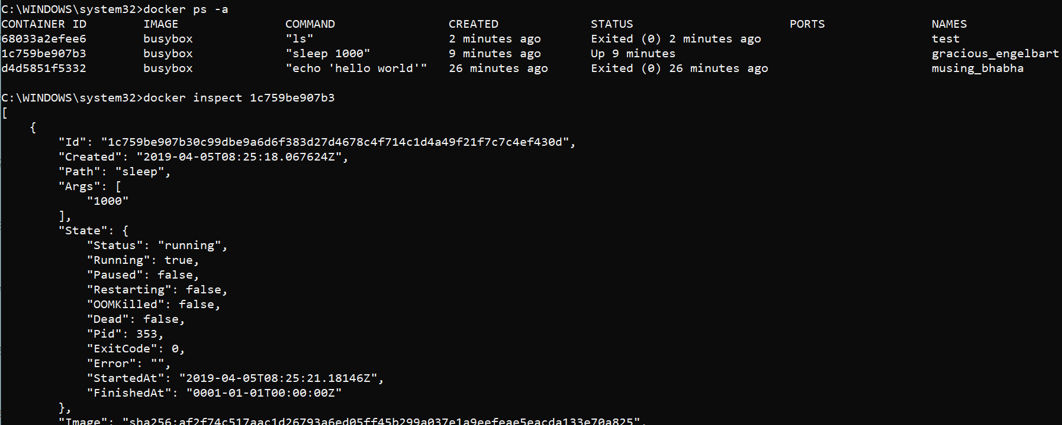
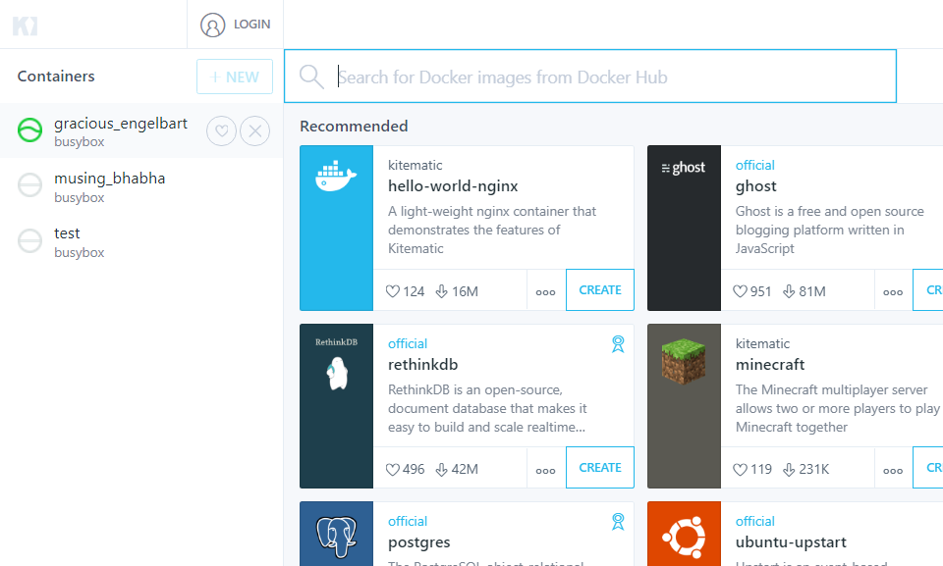
Inspect

Slide 17
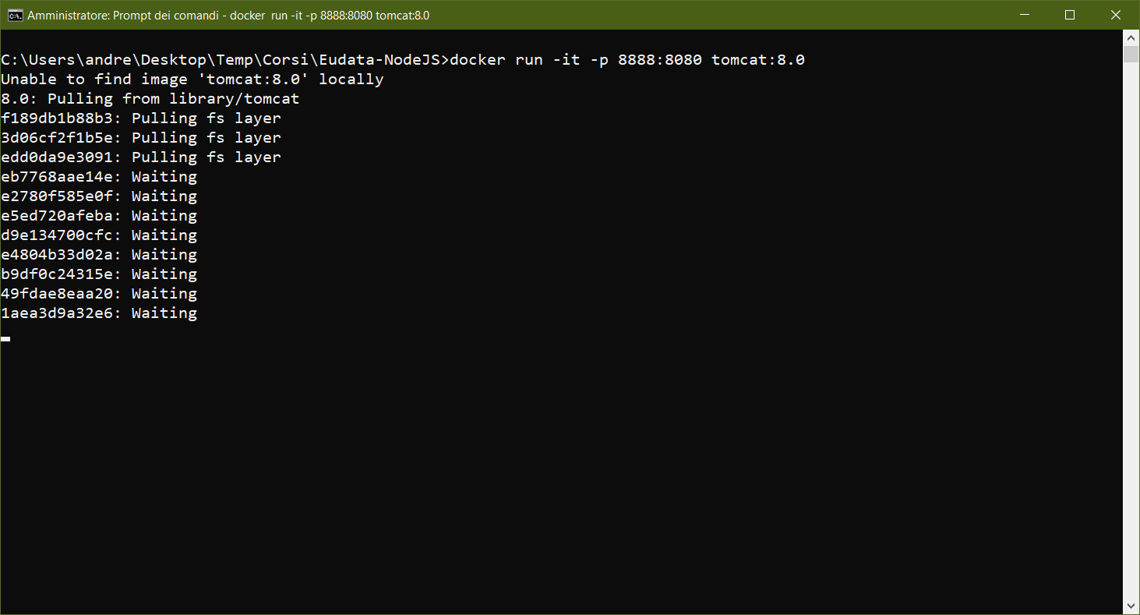
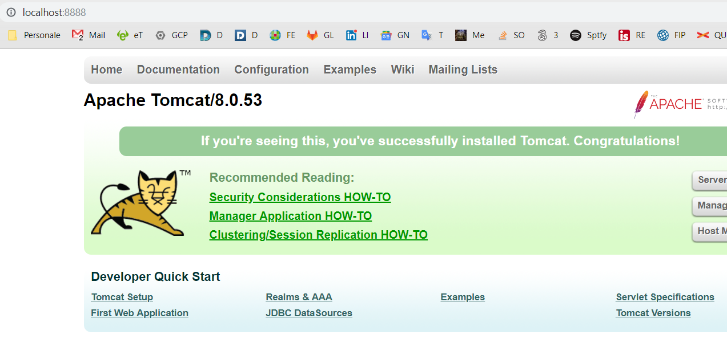
Port mapping

Slide 18
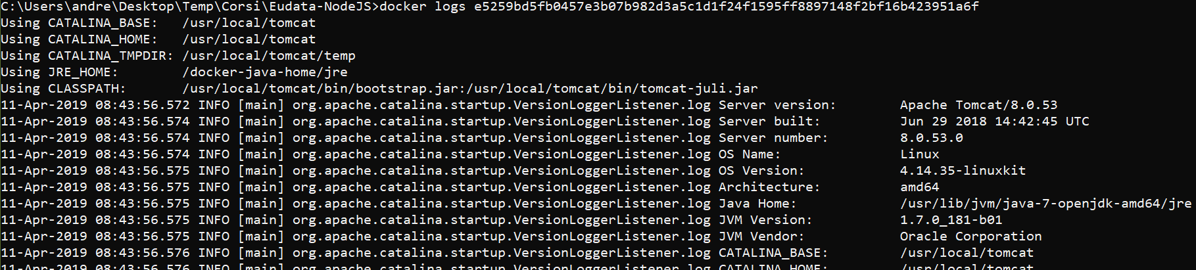
Logs in detached mode

Slide 19
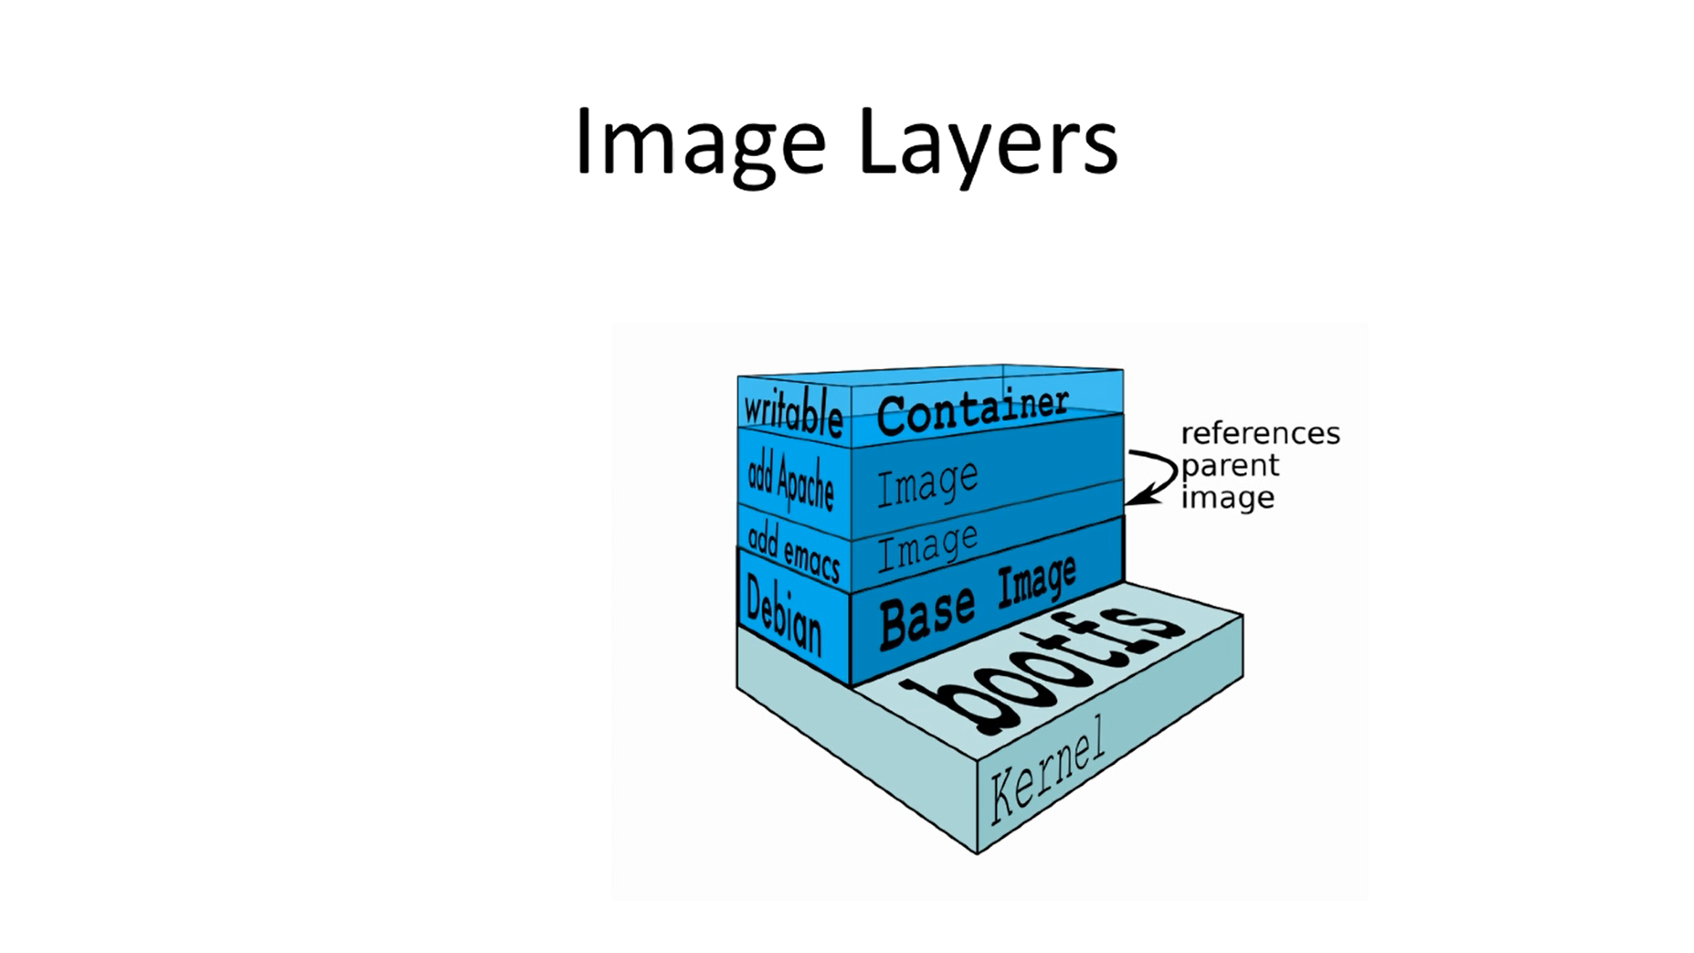
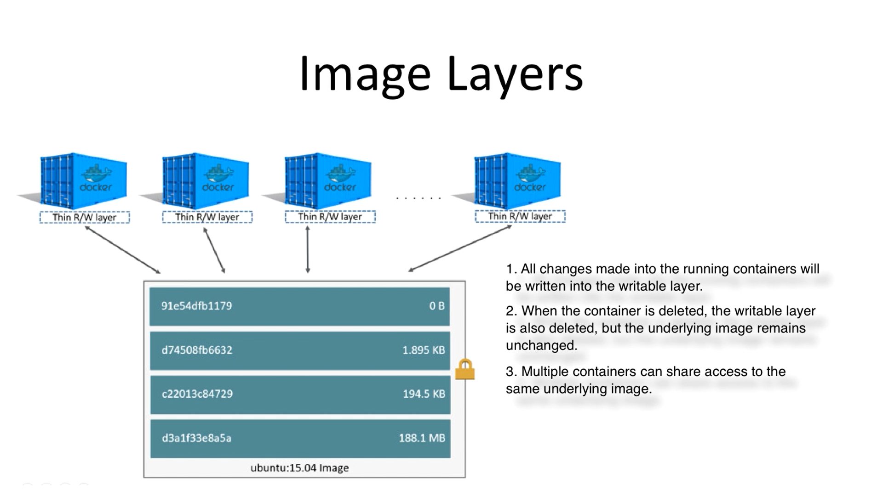
Docker image layers

Slide 20
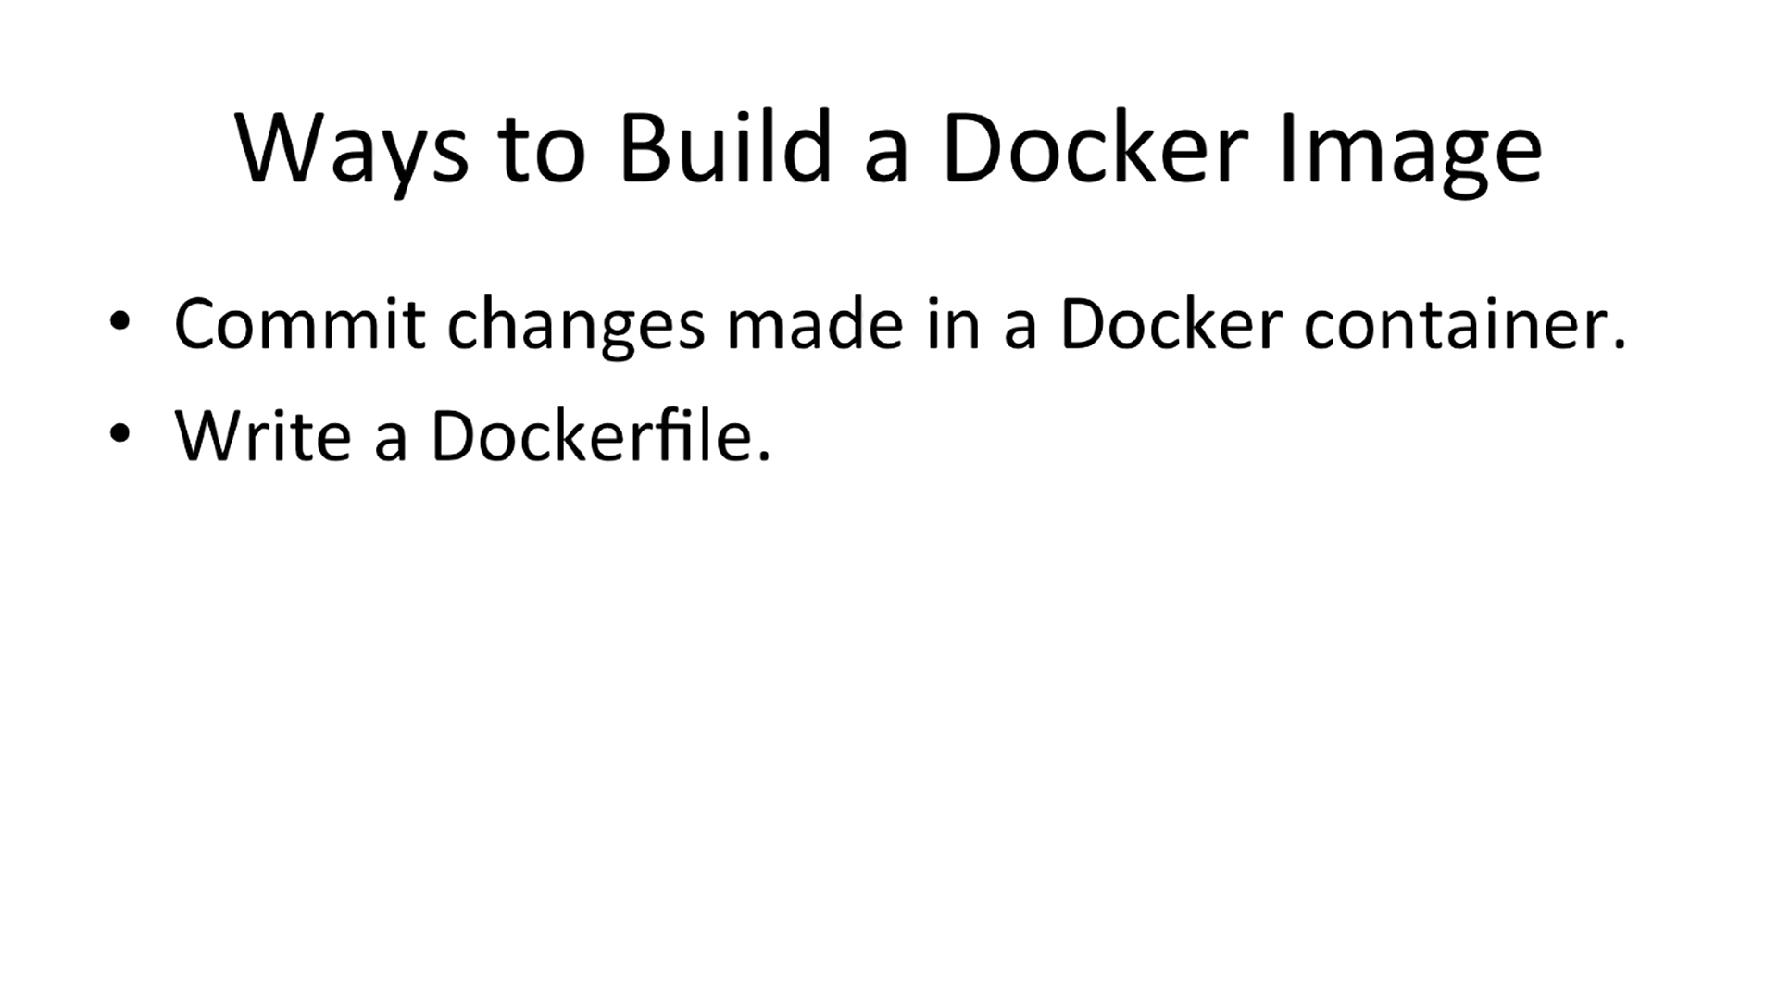
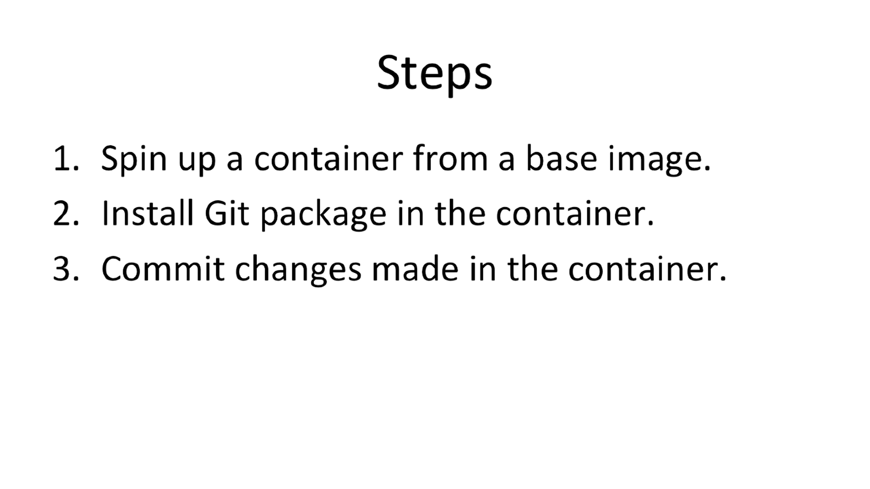
Build a docker image

